Slide 1
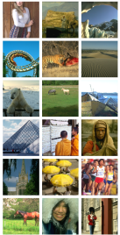
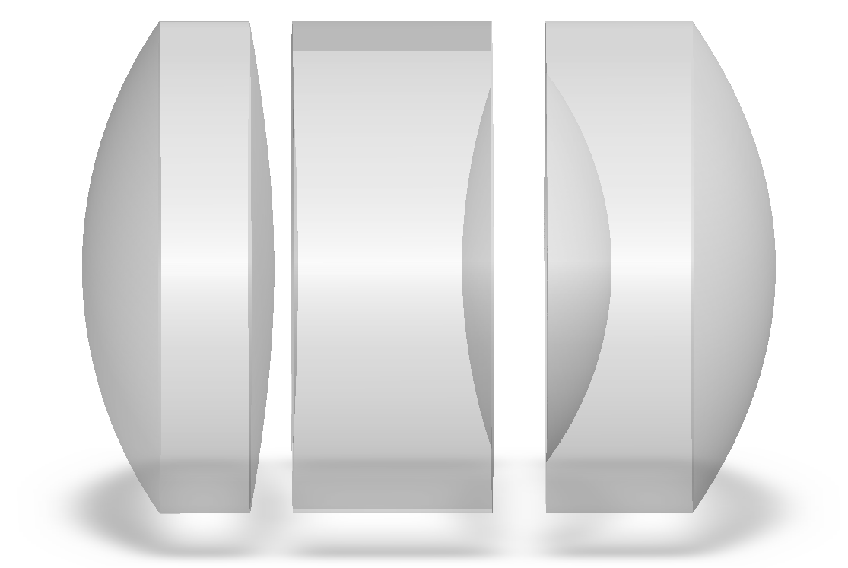
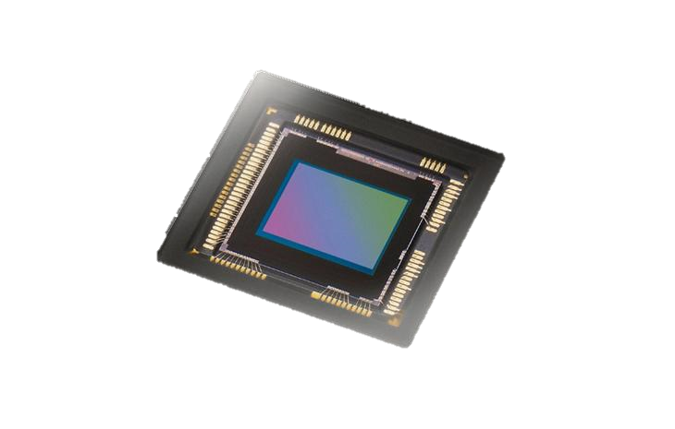
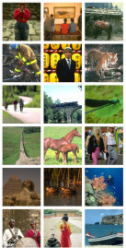
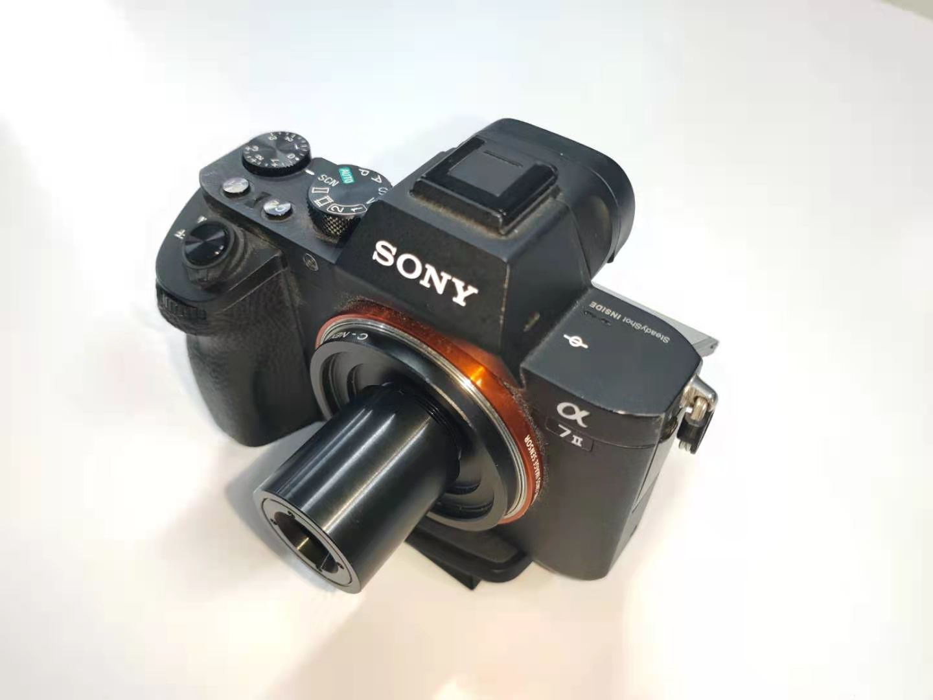
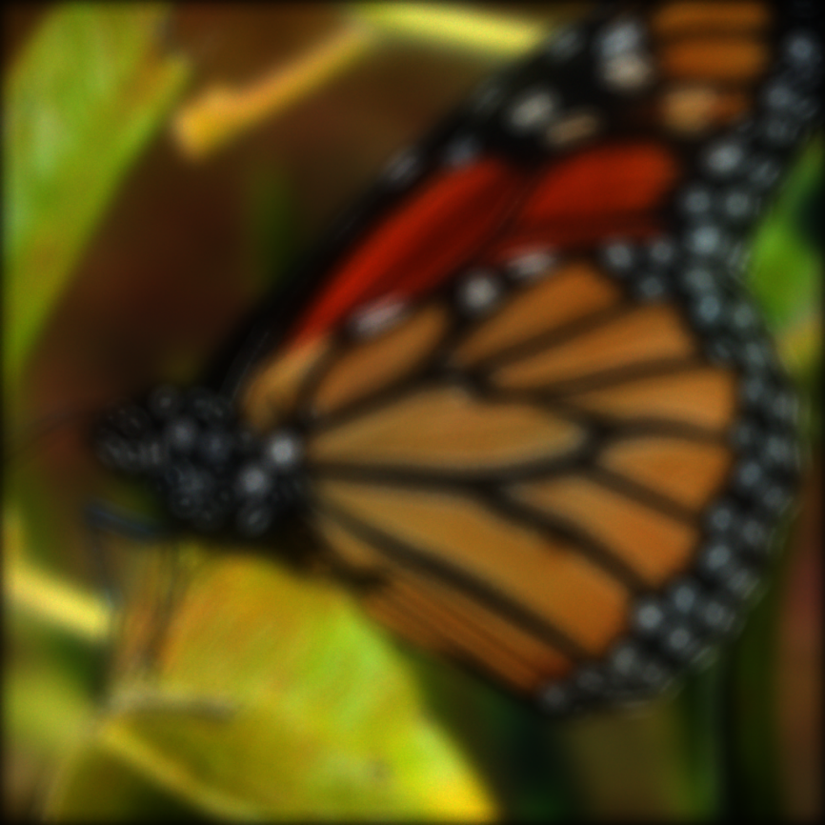
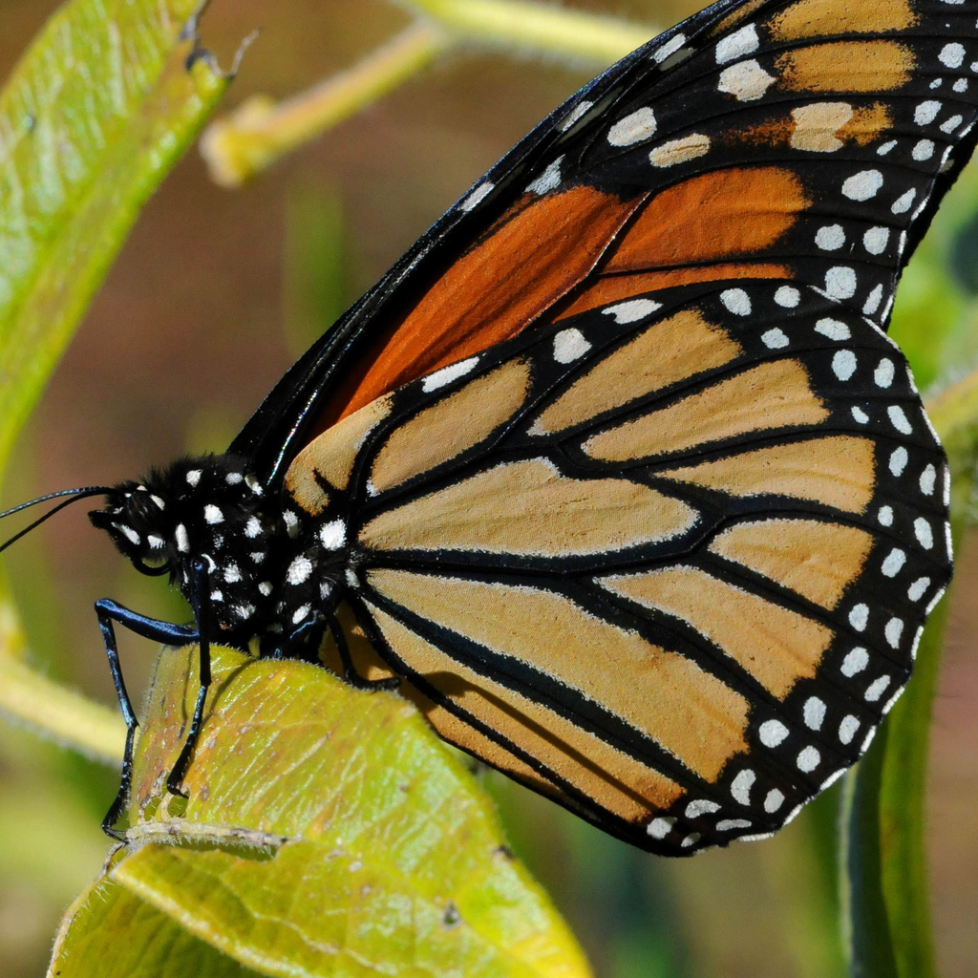
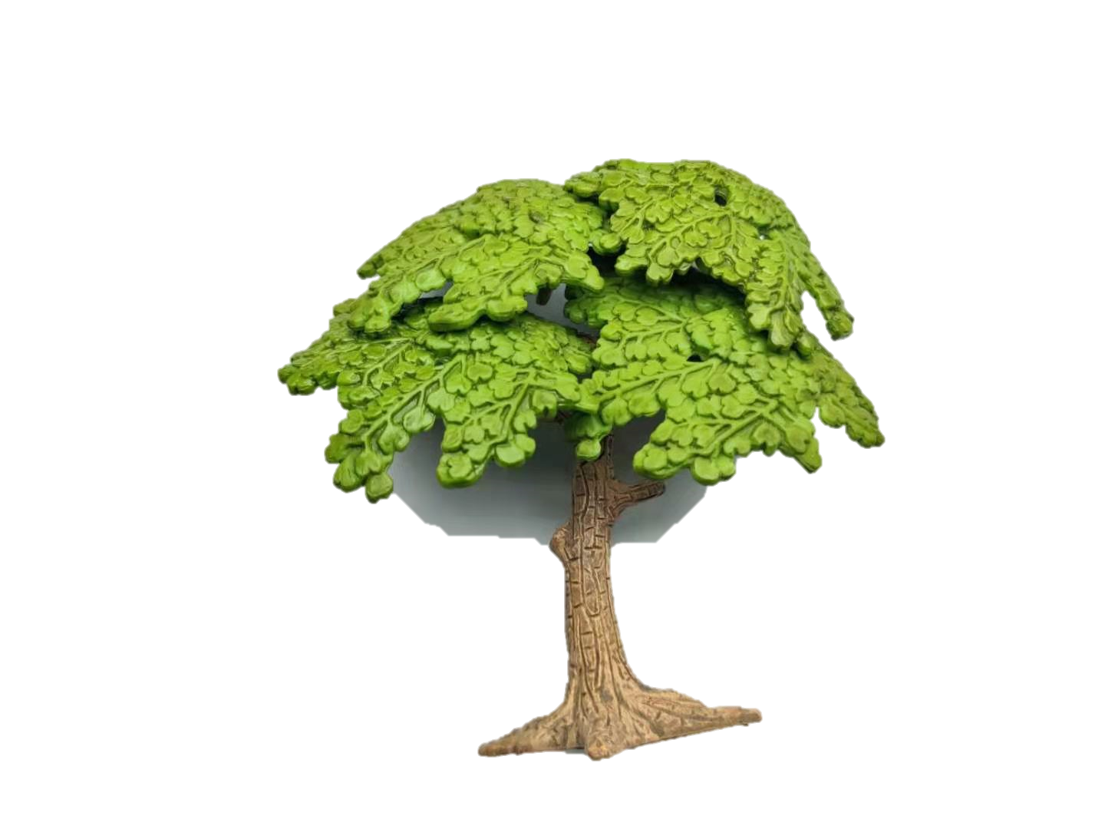
Scene Dataset
Complex Lens Model
Simulated Sensor
Image processing pipeline
White
balance
Color
correction
Demosaicing
Digital
gain
Image
recovery
Gamma
correction
differentiable rendering
Preprocessed rendered image
Real Scene
Prototype
Image Recovery Network
Recovered image
Preprocessed
real captures

Slide 2
